Slide 1
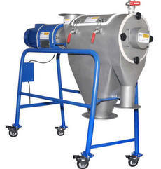
TURBO SIFTER
Mfg.& Exp. Of Plants & Machineries for Pharmaceuticals,
Cosmetics, Chemicals food & Beverage Industries
Plot No. 1601/1,3rd Phase G.I.D.C., Vapi-396195. (Gujarat)
Email:sales@sidhipharmaequiment.com:sidhipharmaequipments@gmail.com:
Contact Person : Mr. Pravin Panchal (9924893790) Mr. Kiran Gophane (9545868896)
Website: www.sidhipharmaequipment.com

Slide 2
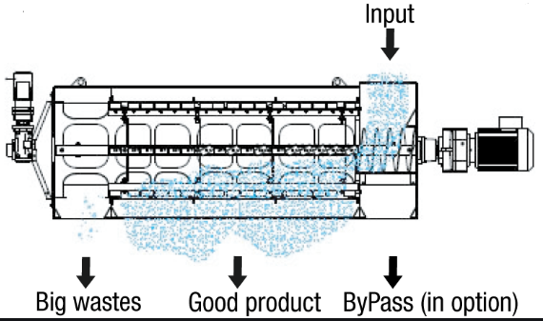
Turbo Sifter :
The TURBO SIFTER is used to combine process for sieving and milling. The turbo sifter mainly used in pharmaceutical formulation for raw material sifting and milling process.
The turbo sifter is having two chambers for sifting and milling with separate drives. The separation of coarse and fine product size happens in the sifting chamber. The sifting chambers having rotary sieve with drive so fed material powder after entering the turbo sifter is pushed towards the sieve area by screw in the sieve chamber gets sifting so, fine powder falls in to directly discharge pot. While coarse particles are proceed to the adjacent milling process. There are sieve and blades with rotary drive in milling chamber, which while rotating push and mill the material against the sieve so coarse particles are broken in to fine and falls to the discharge pot, thus attaining the uniform product size.

Slide 3
Silent Features :
Design is cGMP – Current Good Manufacturing Practices compliance.
All contact parts AISI 316 & non contact parts AISI 304.
Sieving and milling process are in one operation.
Easy movable
Easy to dismantle contact parts for clean.
Enclosed drive for safety.
A C frequency variable speed for sifter and milling drive
Advantageous\ Benefits :
Dust free operations
No vibration and noiseless than 80DB
Flexible design to reduce floor space
Hygienic & high efficient machine design
Easy to inspect mesh frame at 360° smaller particles to pass through without clogging
Direct drive design reduces maintenance cost
No leakage or contamination at the oversize end

Slide 4
Technical Specification :
Single Source Provider for all your technical requirements.
One of the most important “Siddhi Pharma Equipment” guideline is to be closest to our Customers. We strive to create end-to-end solutions that meet our clients needs and their expectation.
Application :
Pharmaceutical
Food
Chemical
Cosmetics
Allied Industry

